Slide 1

Smart Attendance
A Project by –
Snehith Kumar
Chandra Kiran
Sai Teja

Slide 2



Slide 3
Problem Statement
Attendance is an important part of daily classroom evaluation. The attendance system in most of the educational institutions is entry based, wherein the faculties are expected to enter the attendance in software. Teacher has to waste time for the attendance. There are high chances of getting proxy. Objective: To collect daily attendance of students using IOT device to overcome the challenges.

Slide 4
Abstract
Maintenance of manual attendance entry system is cumbersome and time consuming, the classroom time which can be otherwise be used productively is spent for attendance entry, also in cases of high student to teacher ratio there is a chance of receiving proxy attendance. The main objective of this project is to beat all the challenges that teachers face to take attendance on regular basis. With the help of this project we can collect the information regarding the students present in the class using IOT device and return list of absentees after every class to concerned faculty.

Slide 5

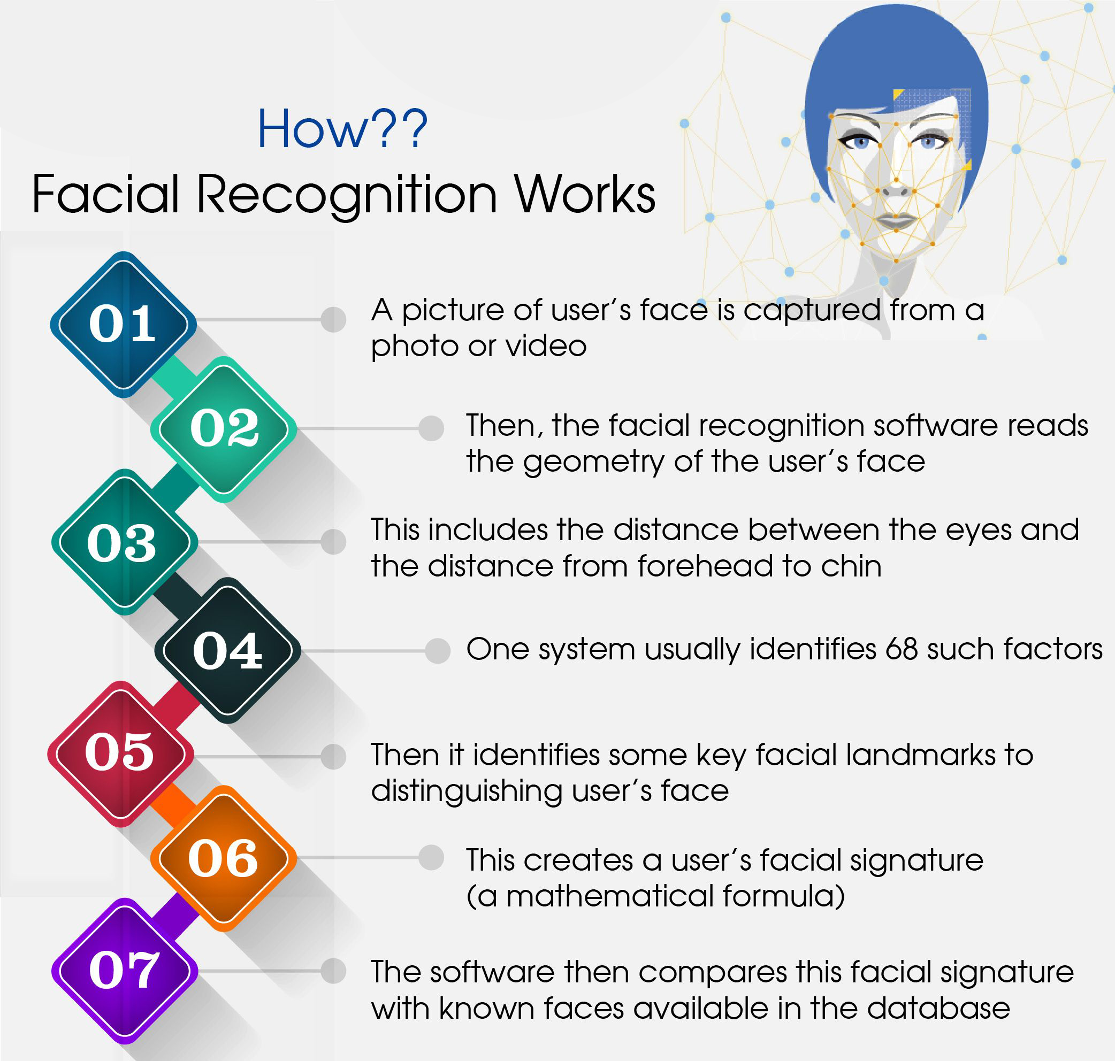
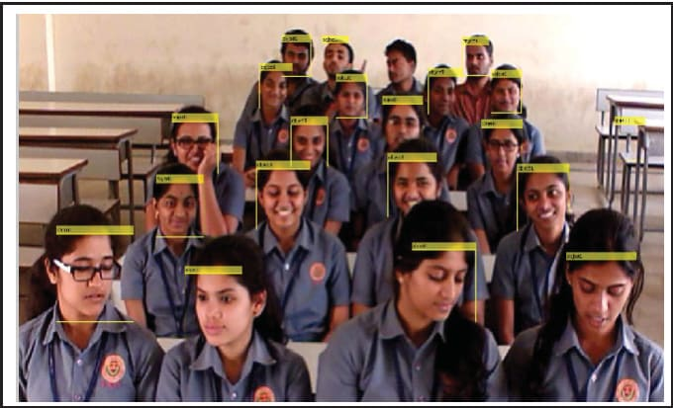
Some existing projects to solve this problem are:
Face Recognition
Disadvantages:
Problem with false rejection when people
change their hairstyle, wear glasses, etc.
2. Less accurate where there is non-step wise
classes

Slide 6
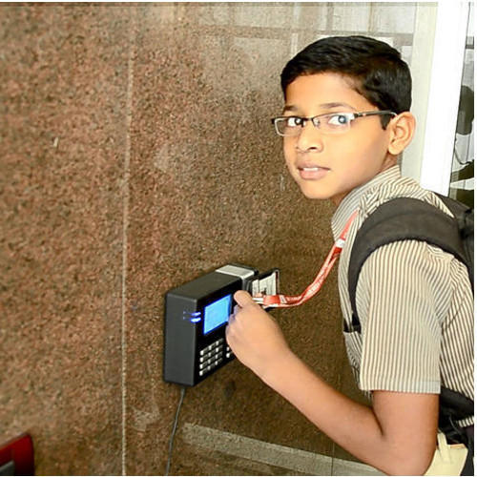
RFID System
Students are issued with RFID cards and their attendance is marked when they touch their card to the RFID reader
Disadvantages:
In case of a large strength of students, purchasing tags for everyone is costly.
2. Students have to wait in queue and repeat the process for every lecture,

Slide 7


Slide 8


Mobile has become a mandatory device for every student

Slide 9

What is MAC Address?
MAC address is the physical address, which uniquely identifies each device on a given network.
It stands for Media Access Control
It is provided by the device's vendor at the time of manufacturing.

Slide 10
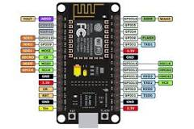
Node MCU:
The NodeMCU (Node MicroController Unit) is an open-source software and hardware development environment built around an inexpensive System-on-a-Chip (SoC) called the ESP8266.
Uses WIFI protocol
We can get device information like MAC address of device, duration of device connected, etc

Slide 11



Tech Stack

Slide 12


Slide 13
Two types of Interactions:
Mobile-MCU Interaction
MCU-MCU Interaction

Slide 14

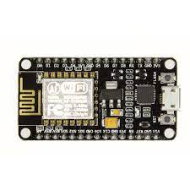
Mobile-NodeMCU
Interactions

Slide 15
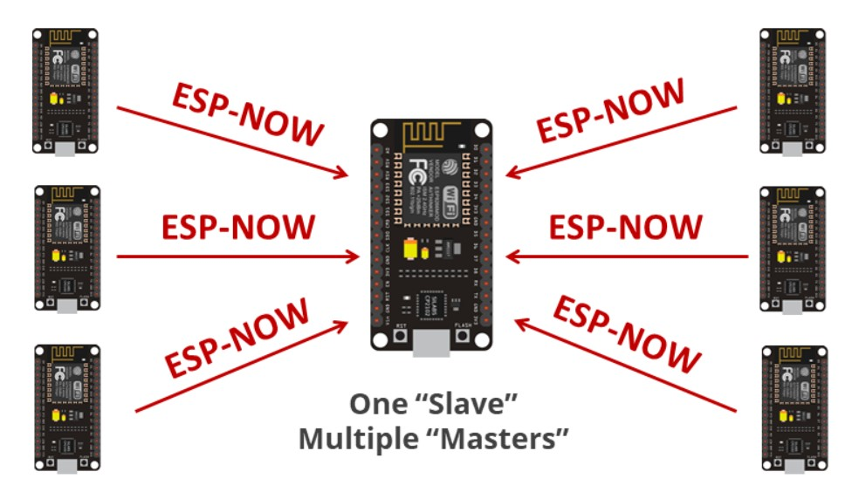
Node MCU-NodeMCU Interactions:

Slide 16
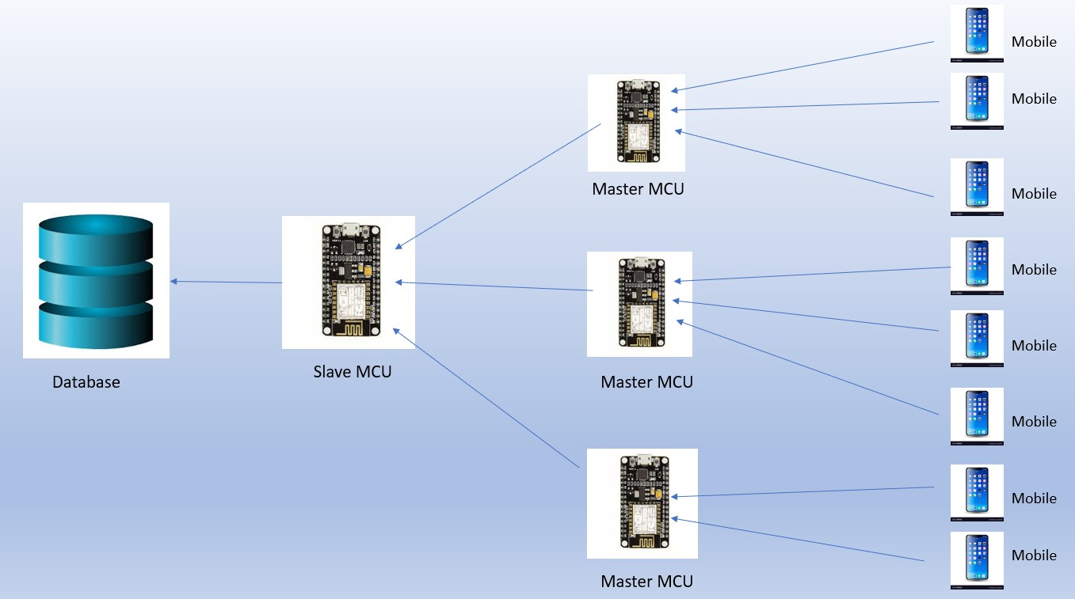

Slide 17
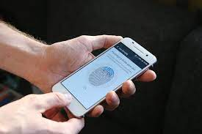
Cloud-based
Biometric
verification

Slide 18
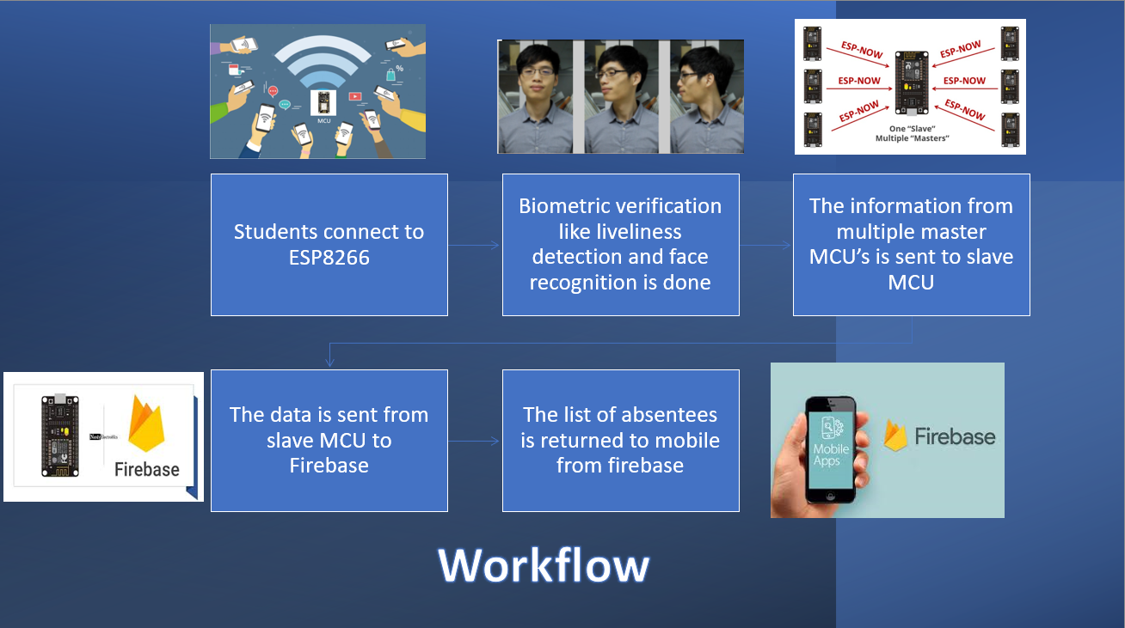

Slide 19
Results

Slide 20
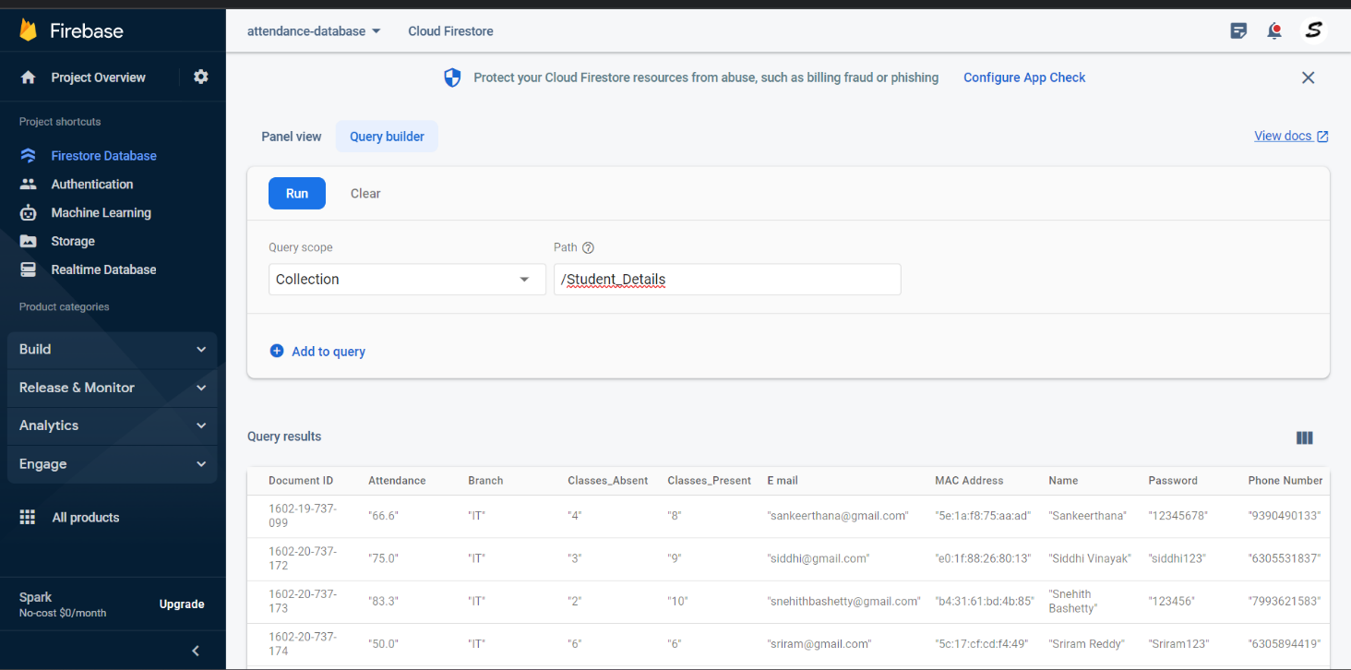

Slide 21
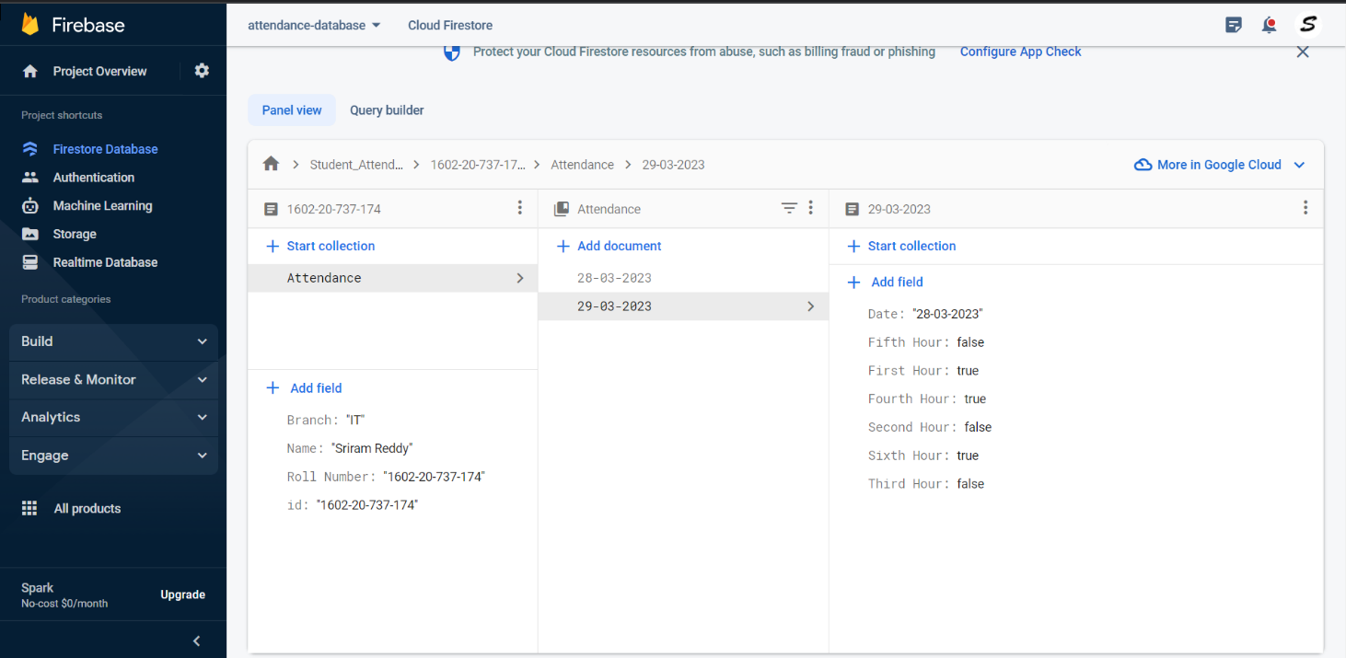

Slide 22
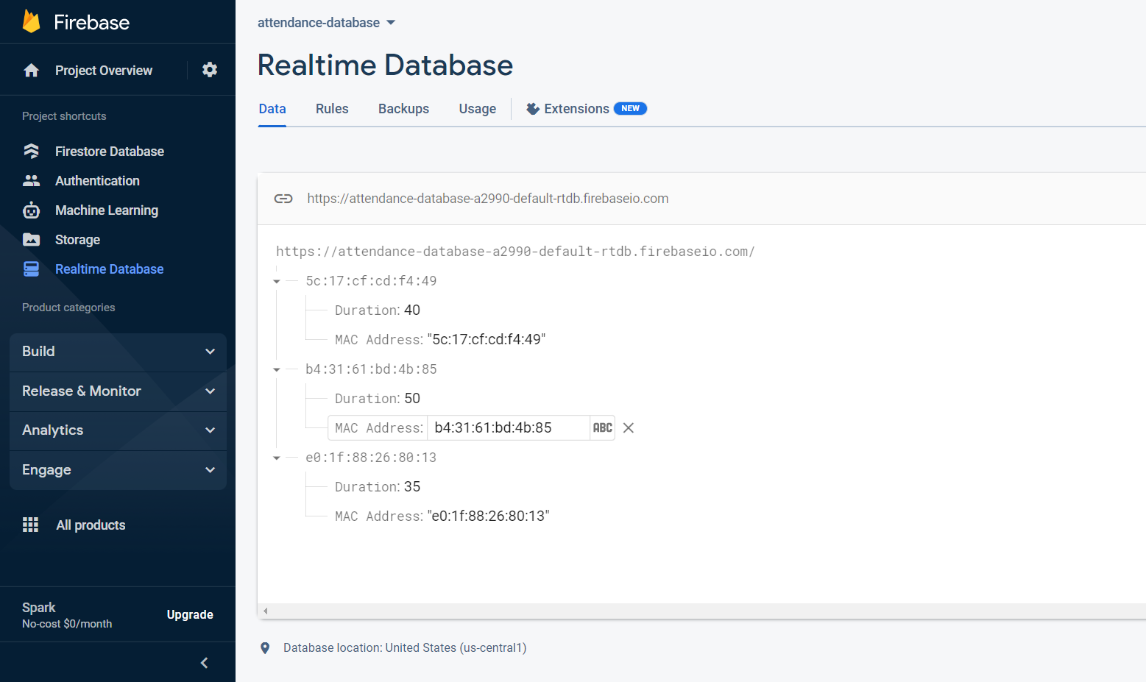

Slide 23
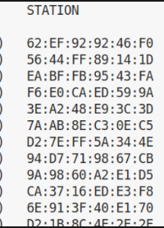
Concept of Random MAC Address:
Starting in Android 8.0, Android devices use randomized MAC addresses when probing for new networks.
MAC randomization prevents listeners from using MAC addresses to build a history of device activity, thus increasing user privacy.
Android generates a persistent randomized MAC address.

Slide 24
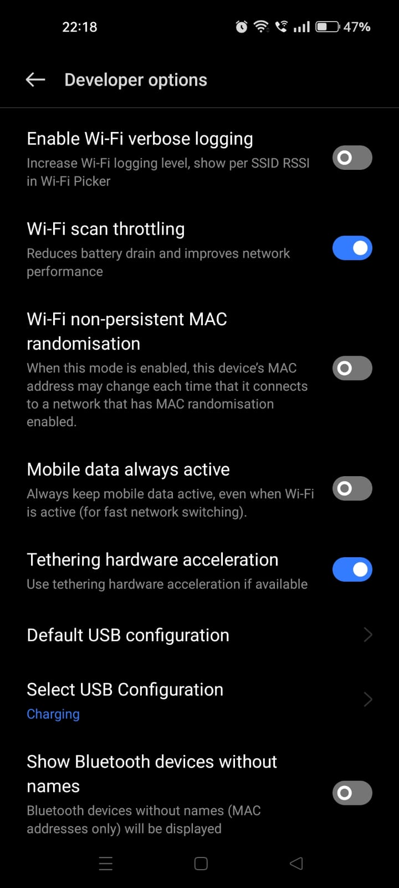
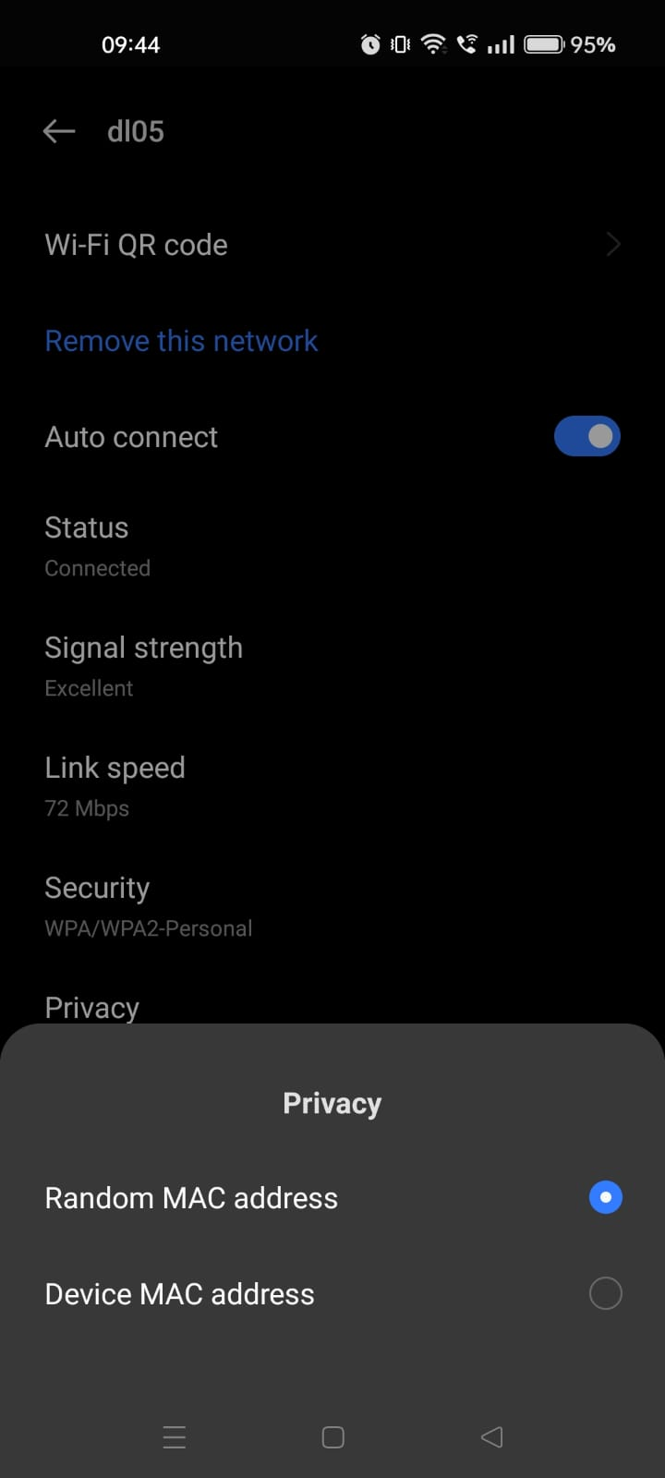
How we can overcome this
Users can enable or disable MAC randomization for individual networks through an option in settings.

Slide 25
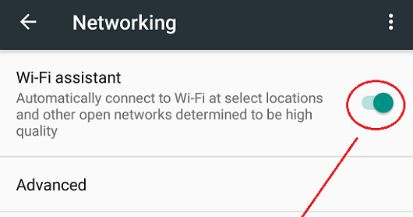
The students should also turn off the Wi-fi Assistant.
Reason:
As this is a data less connection it switches to a data- oriented network using wi-fi assistant

Slide 26

FUTURE SCOPE :
We can add new features as and when we require. We can replace ESP8266 with ESP 32 which has advanced features than ESP8266. The ESP32 is the ESP8266 successor. We can implement cloud-based verifications to get proxy free attendance. Biometric verification includes either fingerprint verification or iris verification. Our Future work is to optimize our idea with latest technology available.

Slide 27
References:
Random Nerd (Communication between ESP8266):
https://randomnerdtutorials.com/esp-now-many-to-one-esp8266-nodemcu/
2. Random Nerd ( Setting up environment):
https://randomnerdtutorials.com/installing-esp8266-nodemcu-arduino-ide-2-0/
3. Android (Random MAC Address):
https://source.android.com/docs/core/connect/wifi-mac-randomization
4. Stack Overflow (for debugging errors):
https://stackoverflow.com/

Slide 28


